Slide 1

Difficult Customers
PASS 2021
Ngiow Jen Sen, Joyful Sound Sdn Bhd
SmAud (Kep.) UKM

Slide 2

Dealing with customers?
Let’s hear some discussion

Slide 3
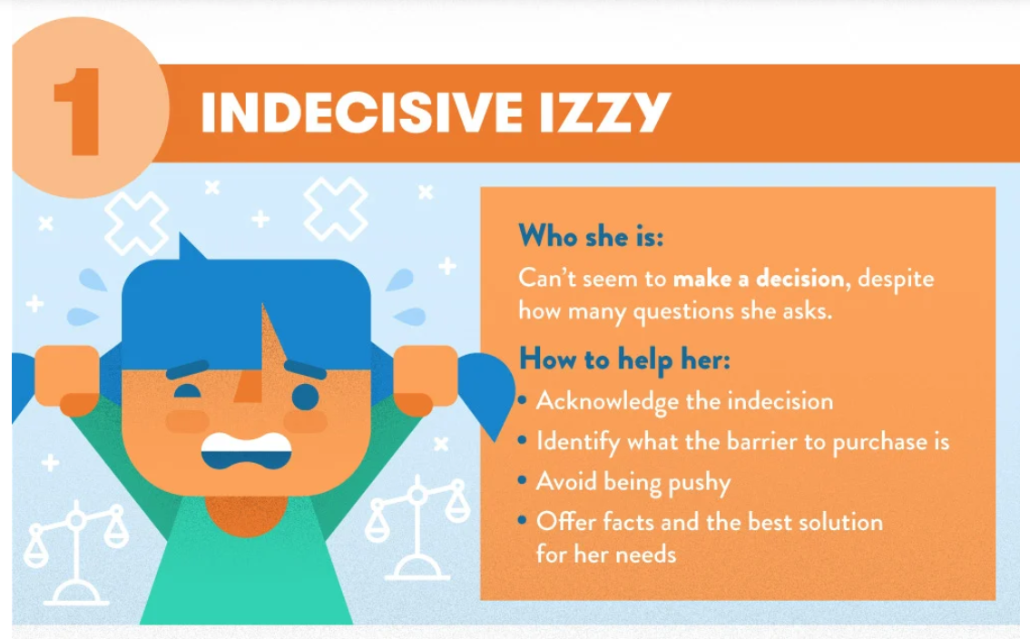
Images taken from www.fundera.com

Slide 4
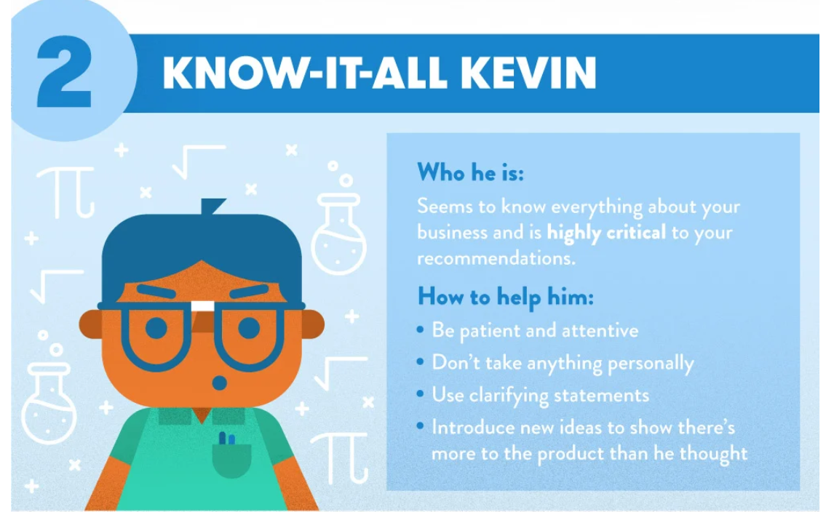
Images taken from www.fundera.com

Slide 5
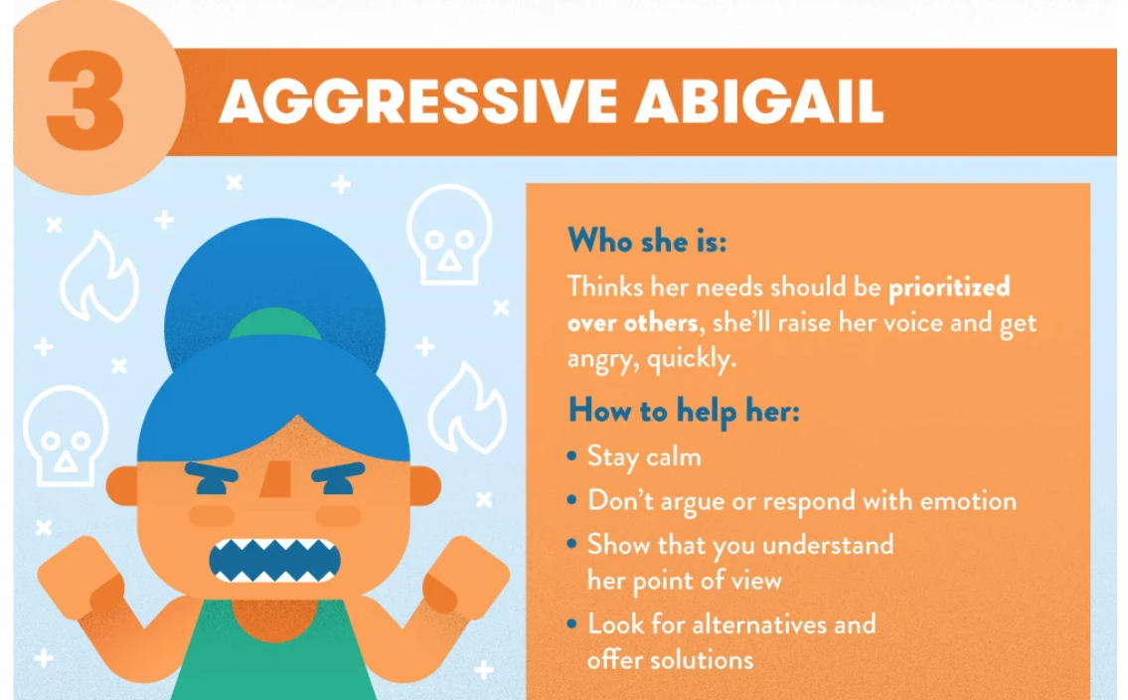
Images taken from www.fundera.com

Slide 6
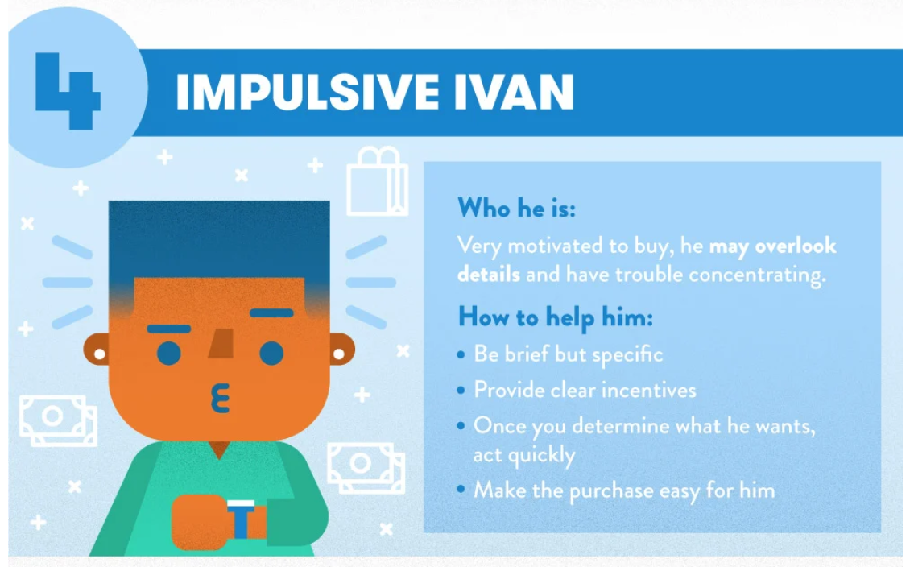
Images taken from www.fundera.com

Slide 7
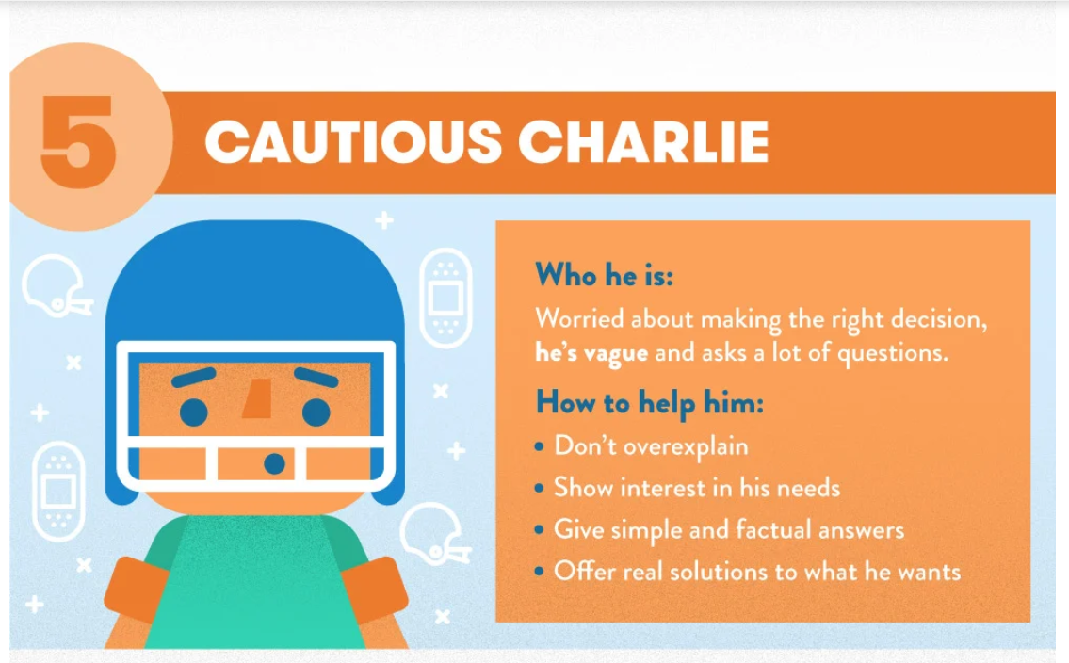
Images taken from www.fundera.com

Slide 8
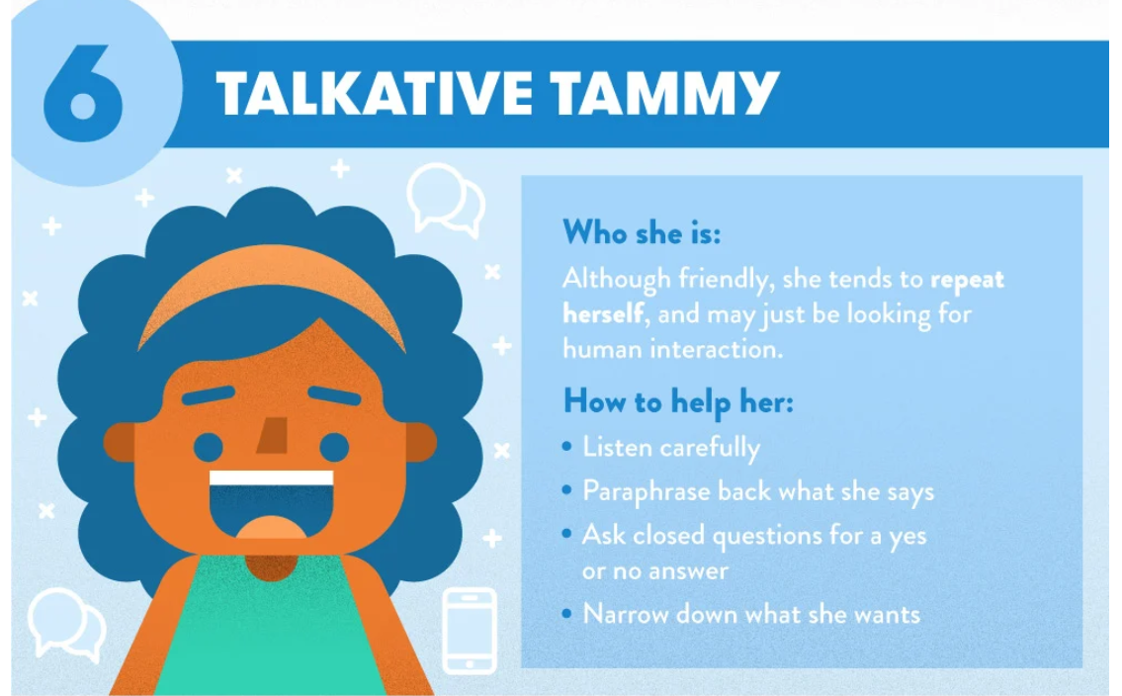
Images taken from www.fundera.com

Slide 9
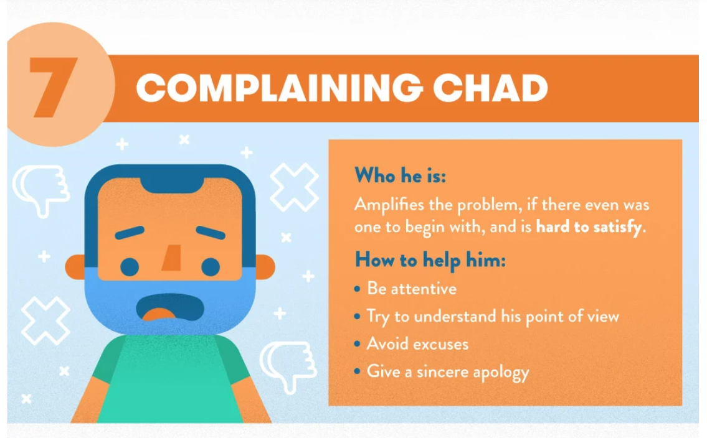
Images taken from www.fundera.com

Slide 10
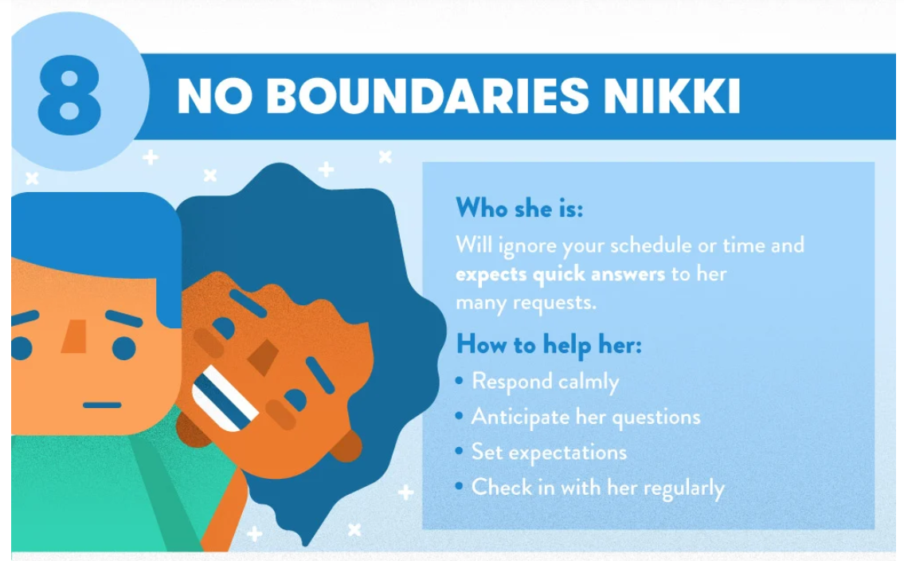
Images taken from www.fundera.com

Slide 11
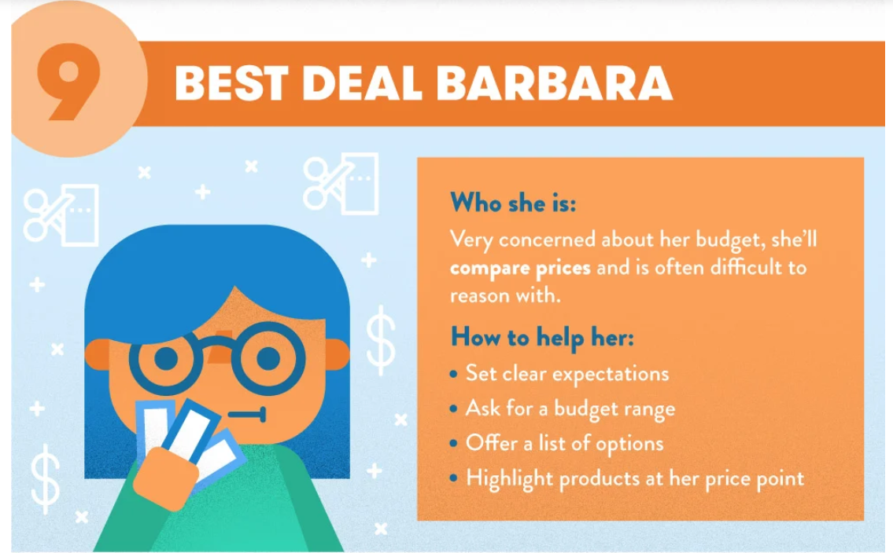
Images taken from www.fundera.com

Slide 12
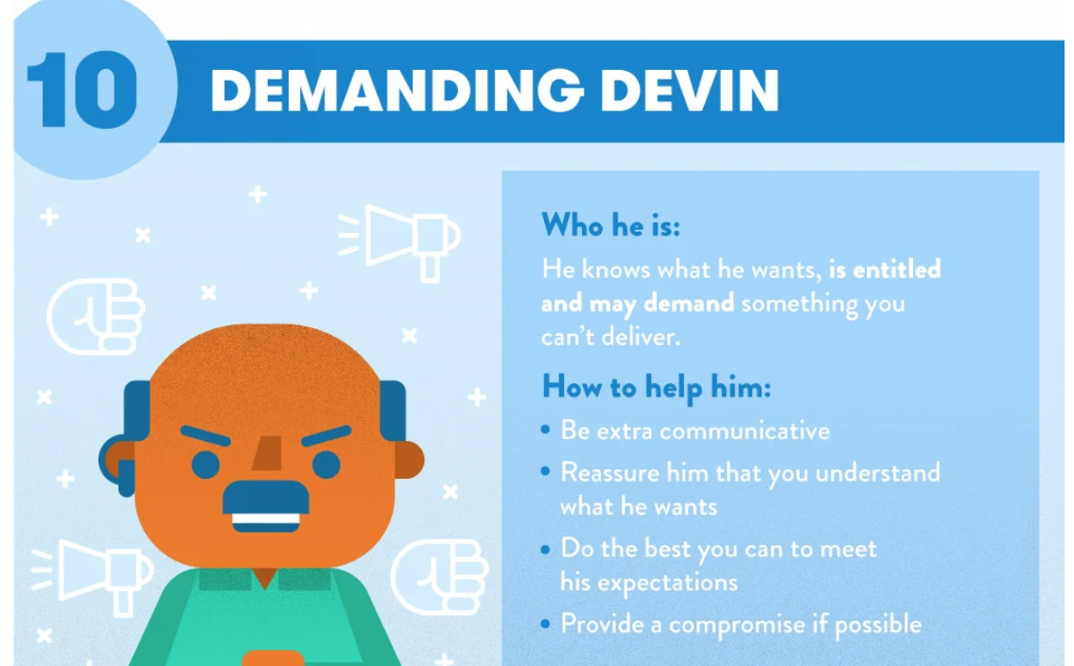
Images taken from www.fundera.com

Slide 13
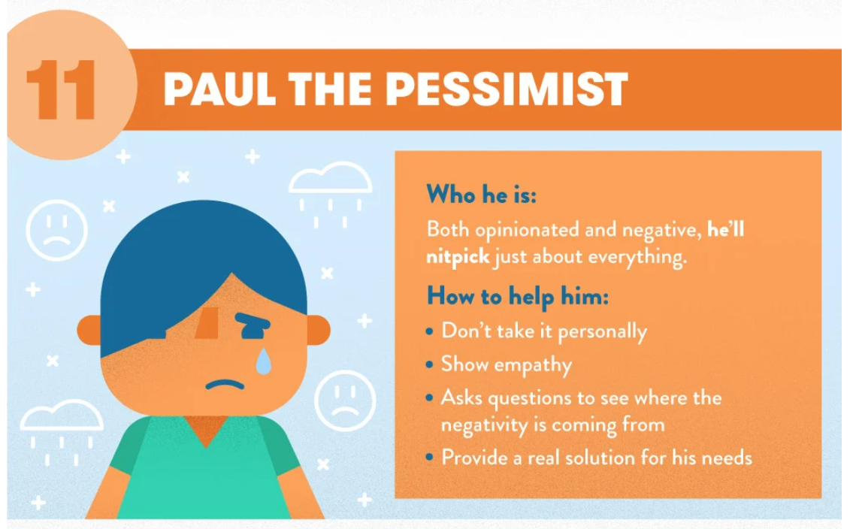
Images taken from www.fundera.com

Slide 14

Listen. Listen. Listen.
Showing empathy through listening
Listen – to build rapport
Listen – to take note
Listen – to empathize

Slide 15

Lower your Loudness.
Speaking slowly and calmly
Pretend there’s an audience
Present mind to hear clearly
Pleasant voice to make their day

Slide 16

Lower your Loudness.
Things to remember
Don’t blame
Don’t get angry
Don’t take it personally
Don’t let the customer leave angry (where possible)

Slide 17

Know Yourself
https://www.16personalities.com/free-personality-test
Take Personality Test
Talk to your Trusted Friends
Try to reflect your actions.
IDA Institute
Reflection - http://www.alps-cetl.ac.uk/documents/Reflection_BAA_article_submission.pdf

Slide 18
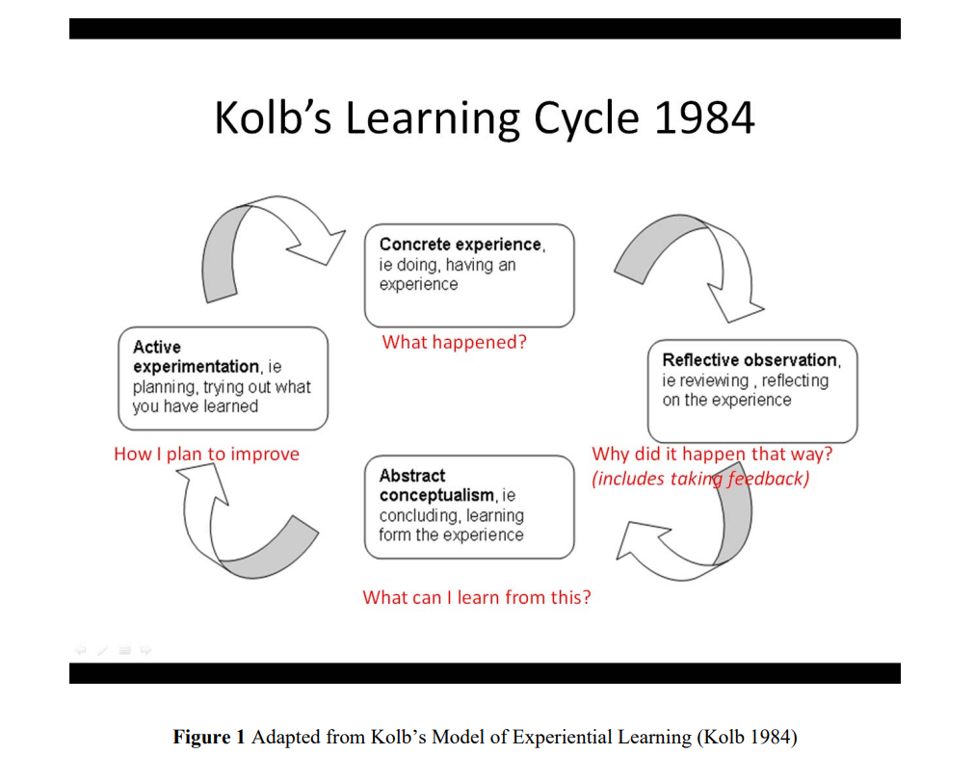

Slide 19

THANK YOU!
Ngiow Jen Sen
Phone:
016-6110138
Facebook:
Audiologist In Malaysia (AIM) | Facebook

